Slide 1

Welcome to Talk Money
Let’s talk money!

Slide 2

Did you know?
Did you know… the most common things children aged 7 to 15 spend their money on are clothes and shoes.
Did you know…
the skills we need to manage our money start to develop between the ages of 3 and 7!

Slide 3
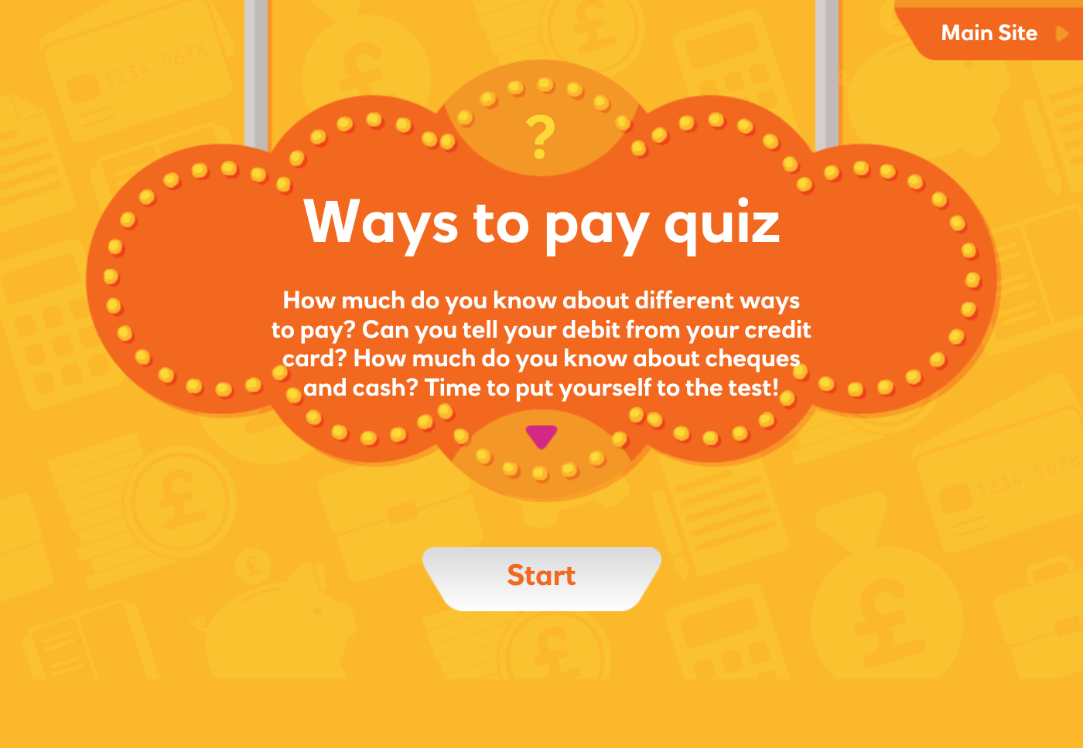

Slide 4
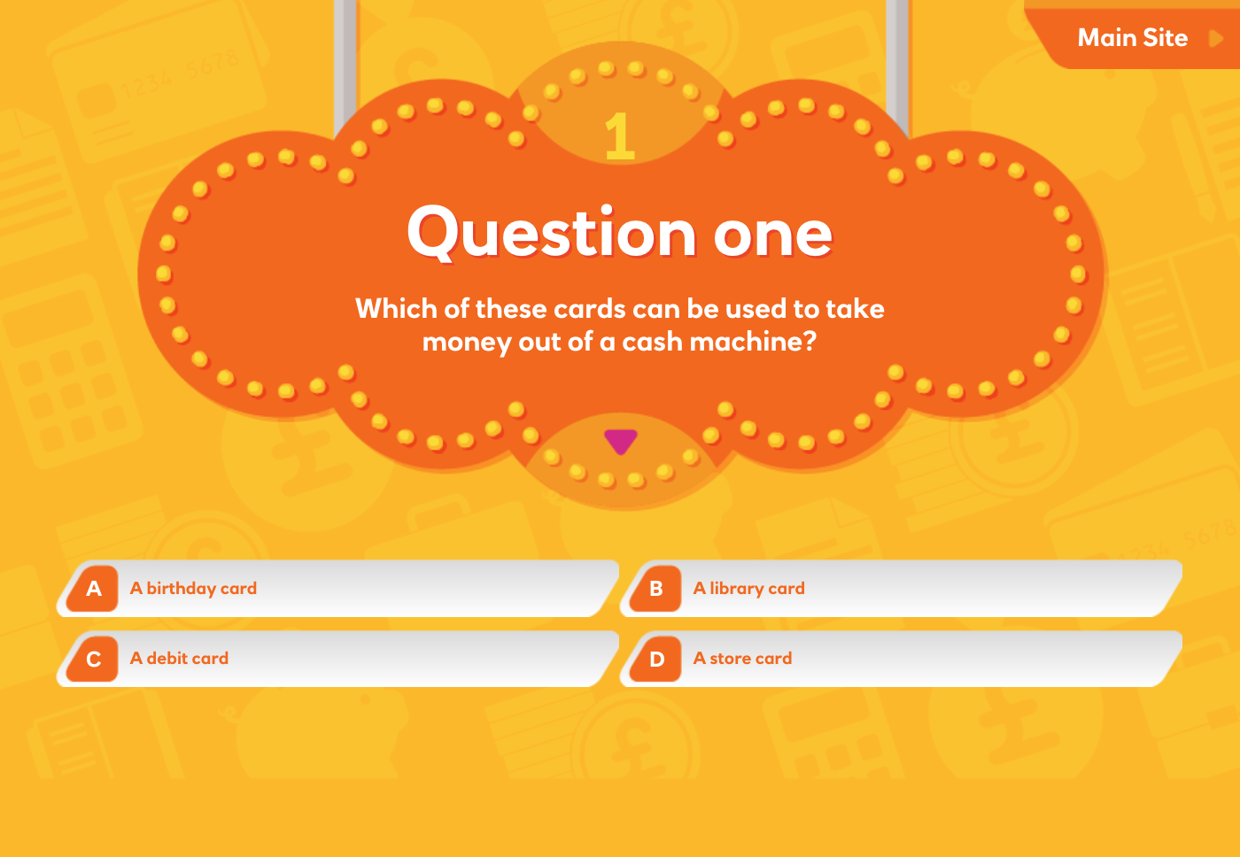

Slide 5
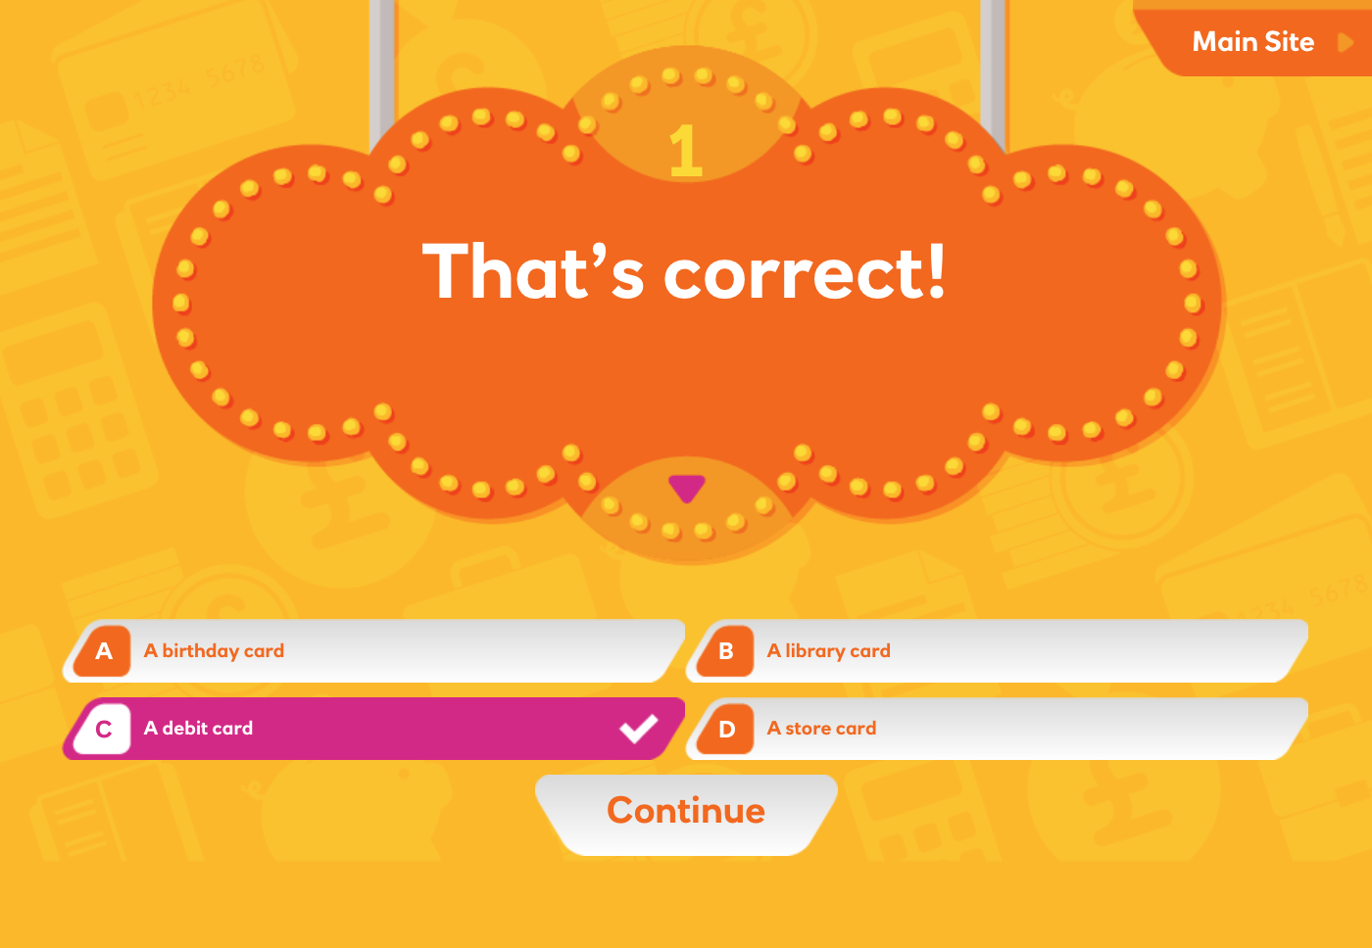

Slide 6
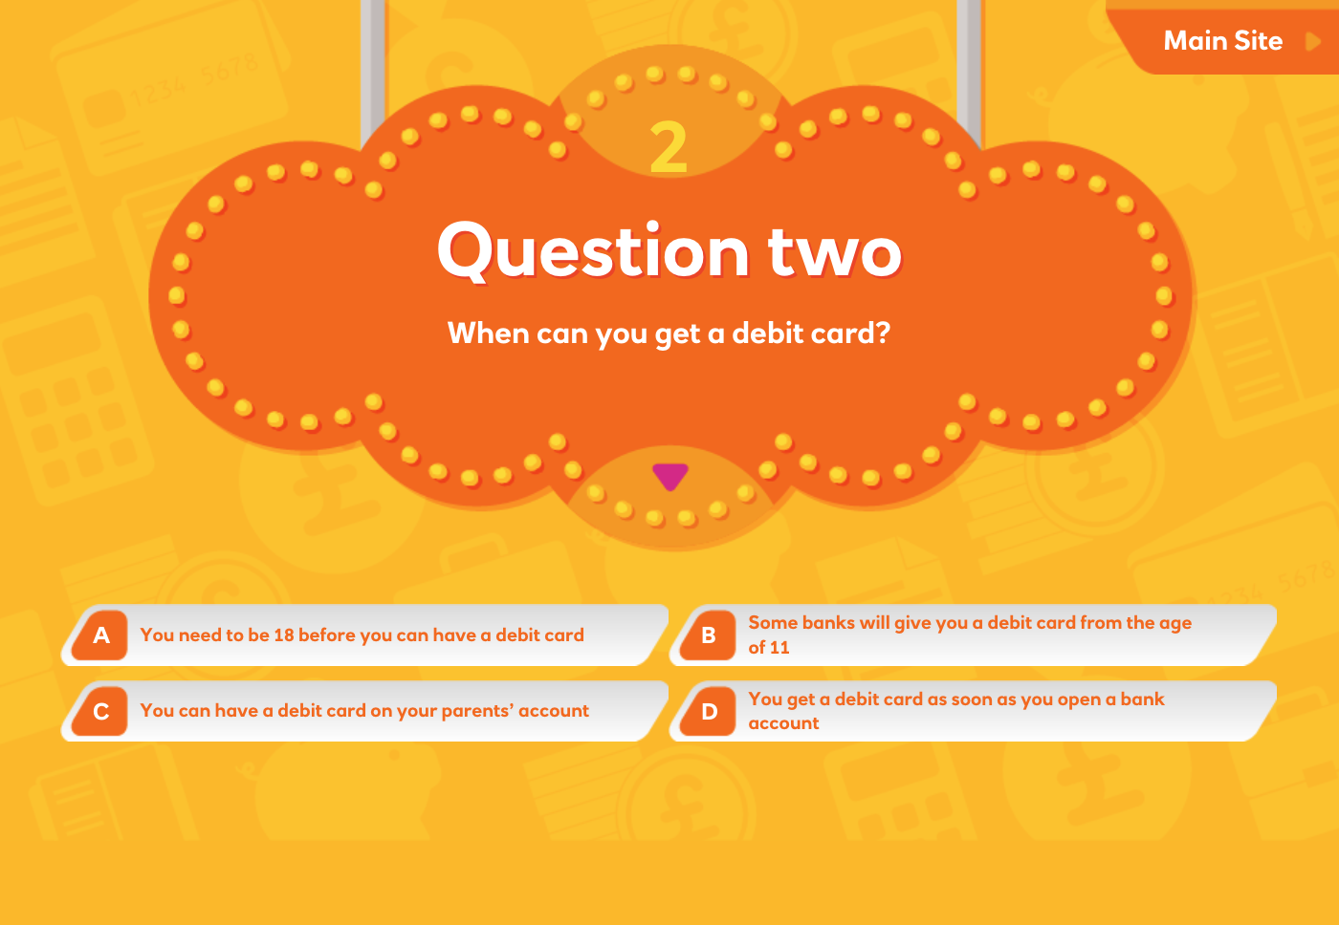

Slide 7
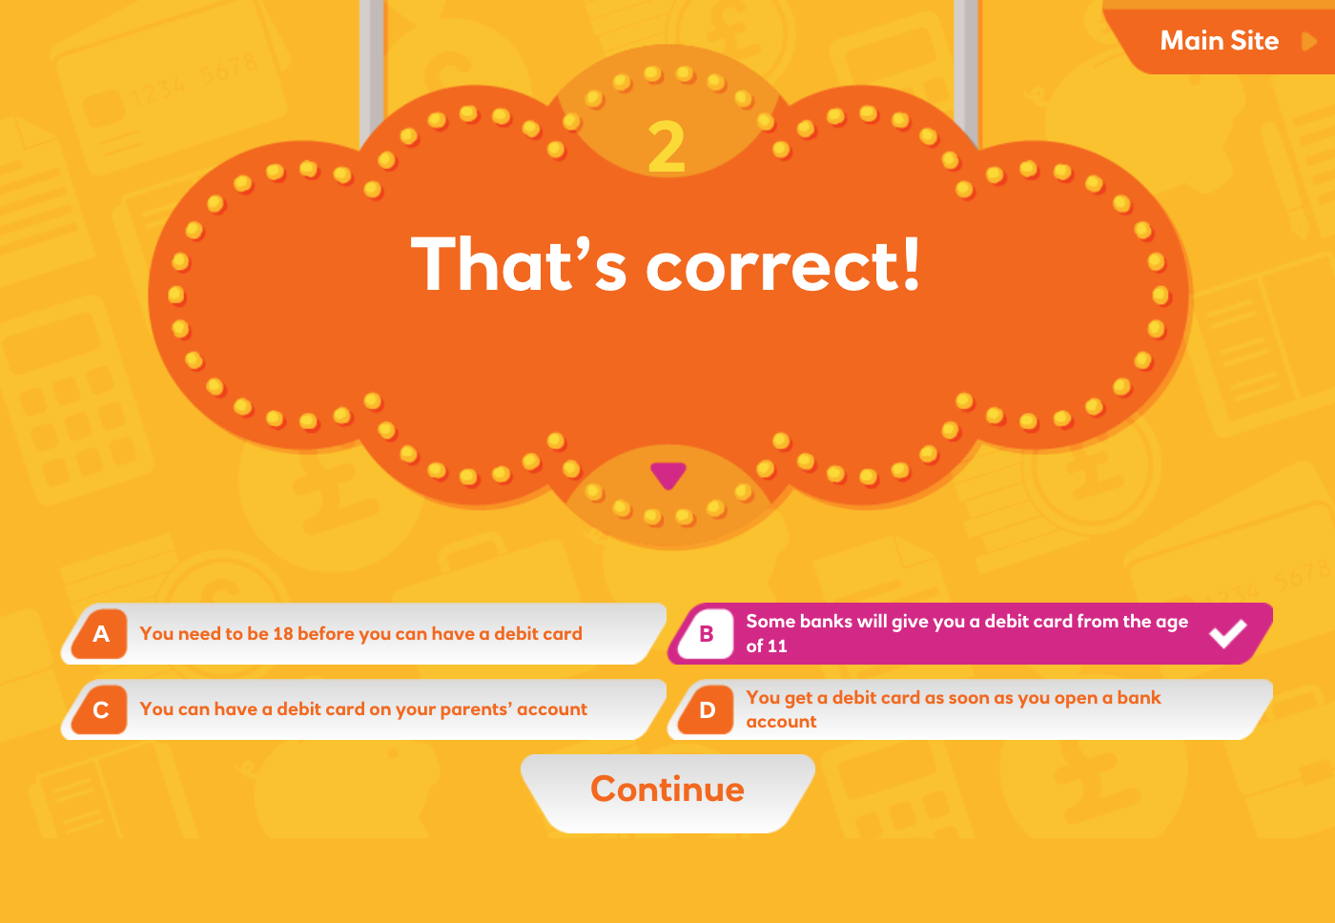

Slide 8
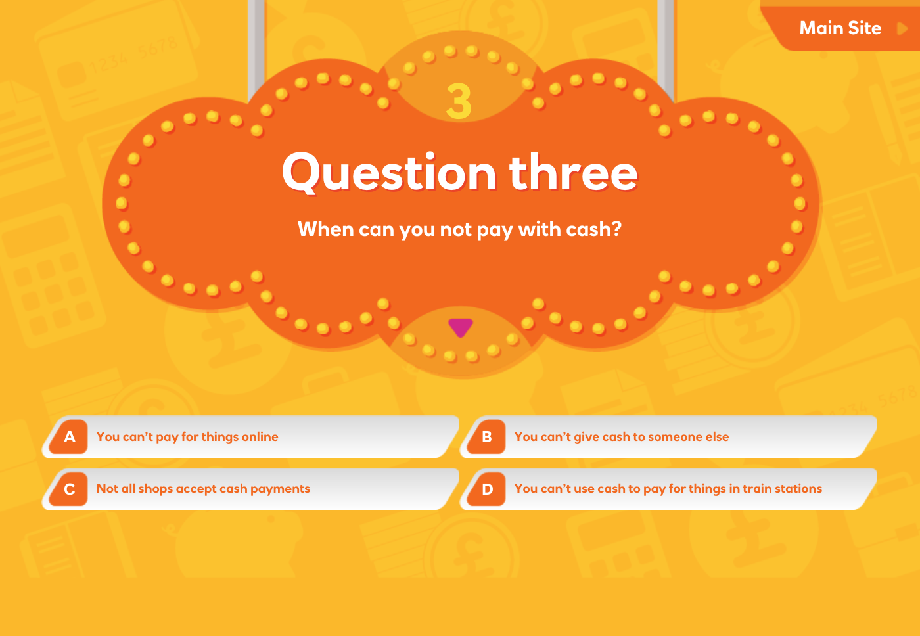

Slide 9
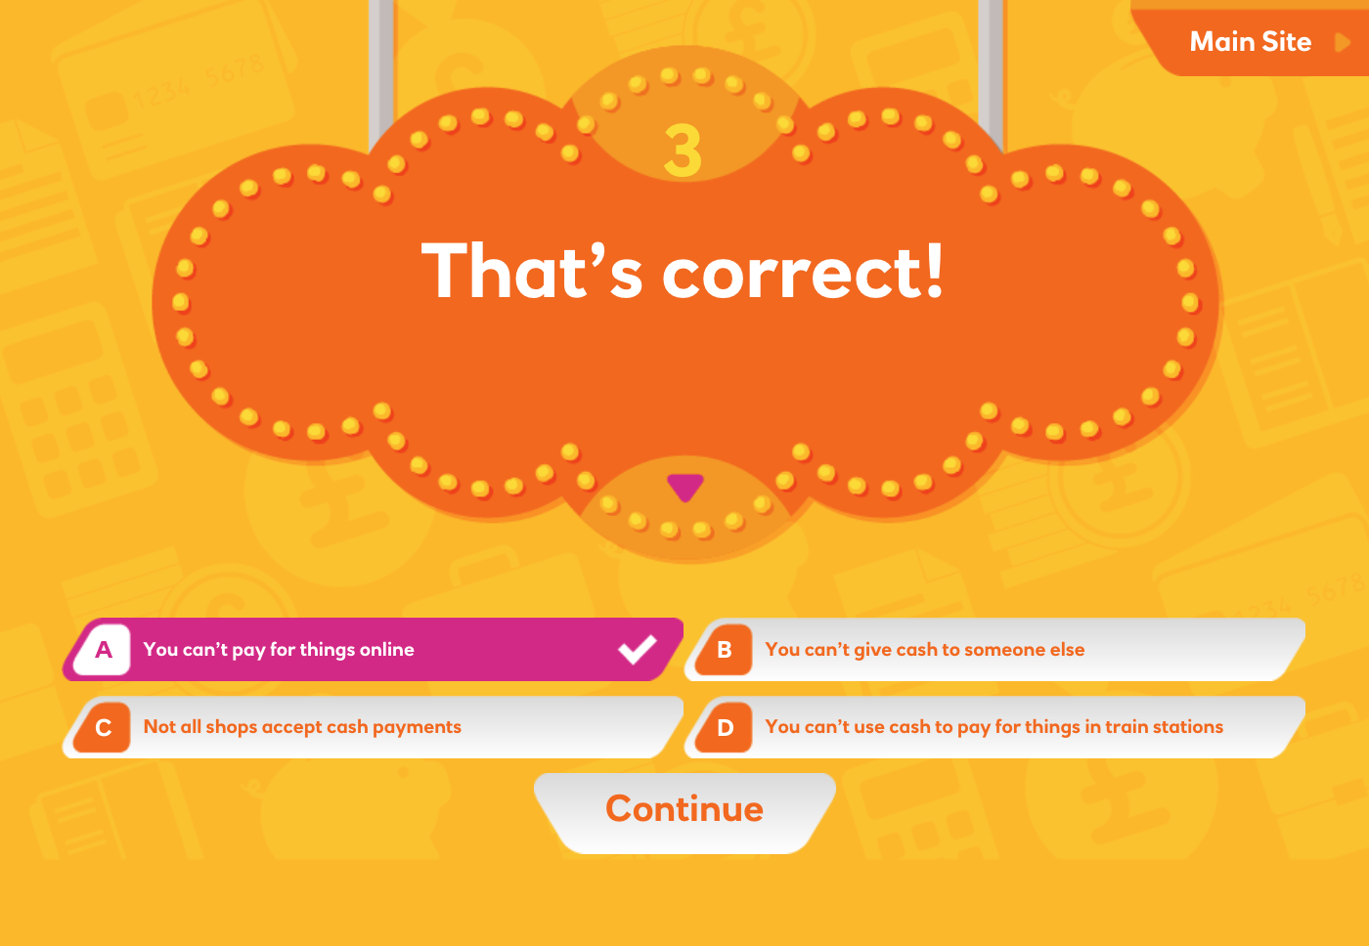

Slide 10
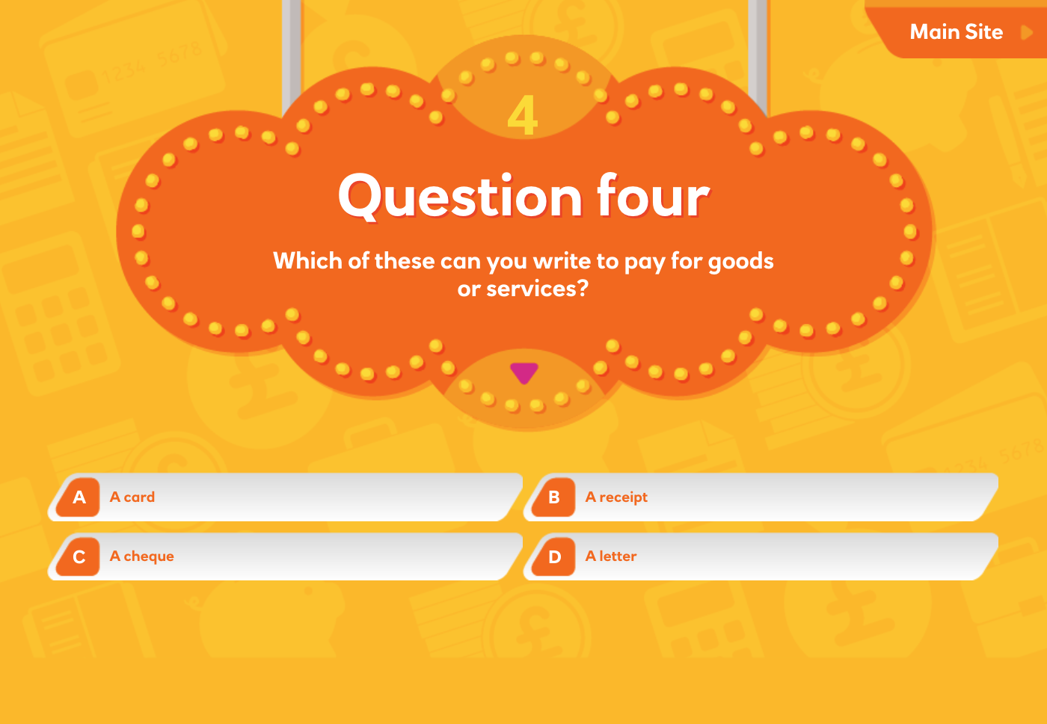

Slide 11
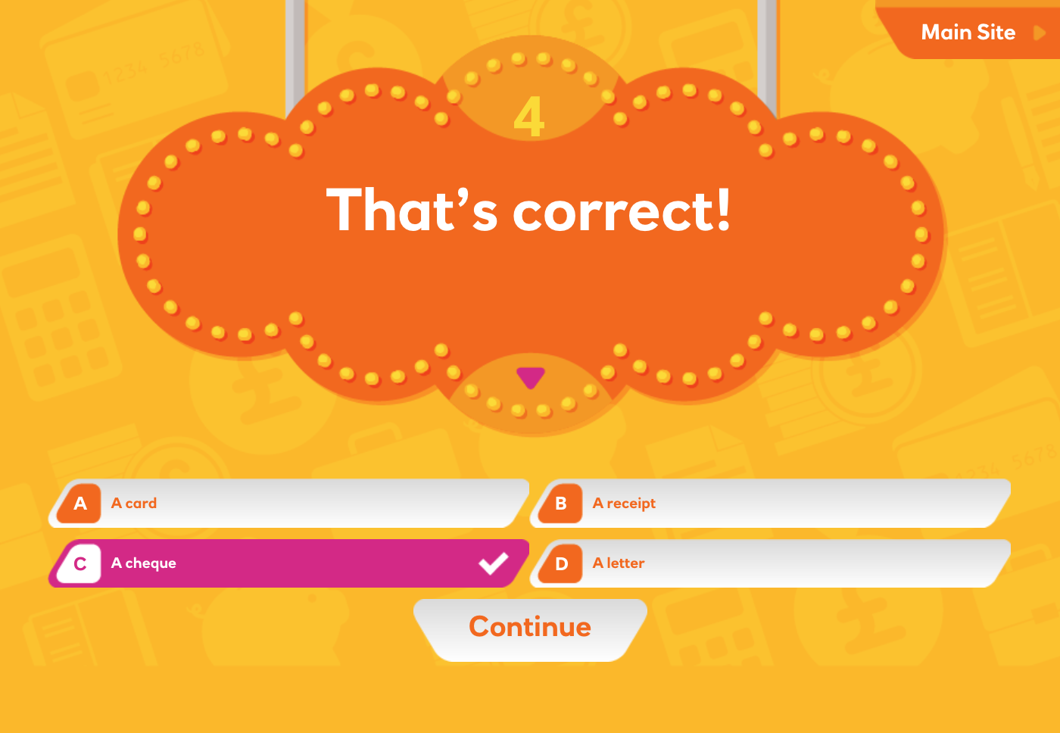

Slide 12
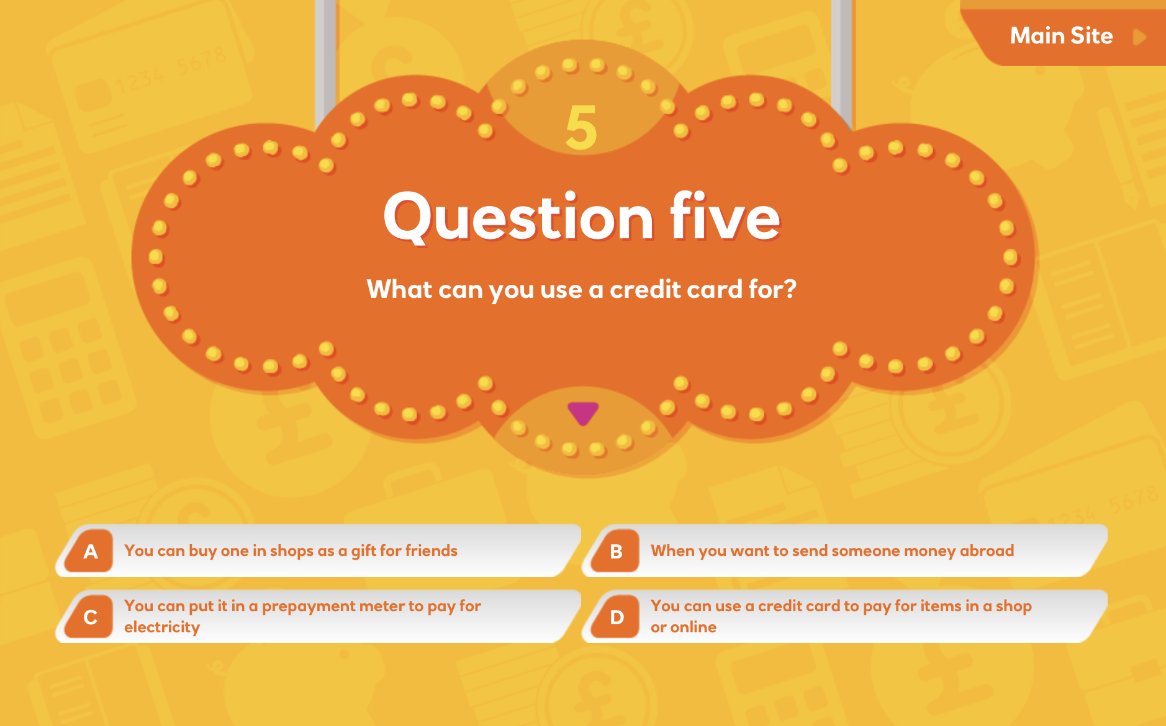

Slide 13
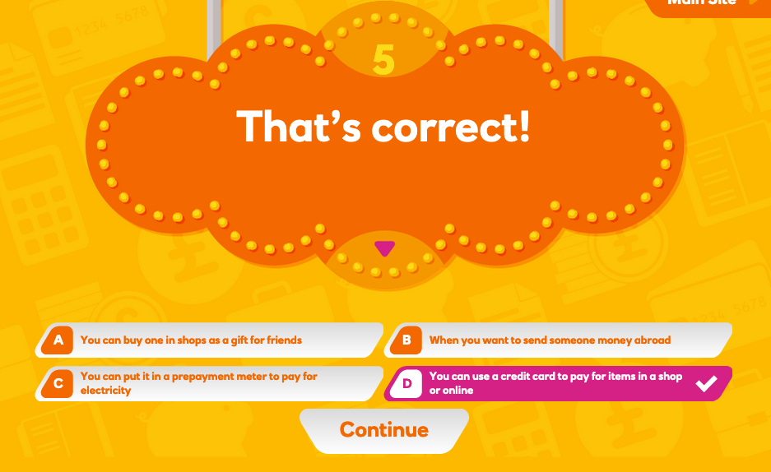

Slide 14
This year’s Talk Money Week theme is credit
What is credit?
A credit is an amount of money added into your bank account.
When you borrow money to pay for something it’s also called credit.
You’ll need to pay it back and often have to pay a cost called ‘interest’.

Slide 15
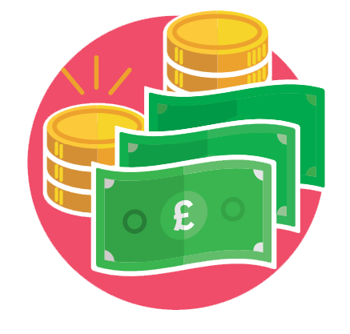
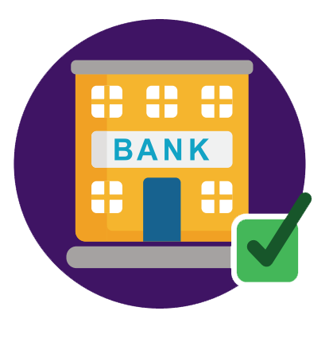

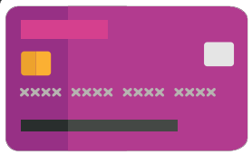
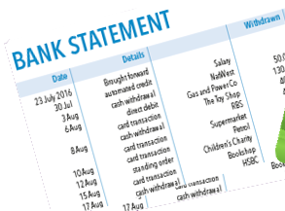
Types of credit
Which of these have you heard of?
1. Money you borrow from family or friends to pay for something.
2. A credit card which lets you spend now and pay back at a later time.
3. Money loaned from the bank. You pay it back monthly.
4. A mortgage is a large bank loan, used to pay for a house or flat. You pay it back monthly over many years.
5. An overdraft lets you borrow money from your bank account which you can pay back.

Slide 16


Types of credit
Is credit a good or bad thing?
It can be helpful, if you are able to pay it back.
It’s not so great,
if you can’t repay.
It’s not so great, if it affects your relationships with friends and family.

Slide 17




How does money
make you feel?
Read this story and pick an emoji to show how you think you might have felt.
You have borrowed
some money from your parent/guardian to help
buy a video game.
You will pay the money
back across the next
six months by having a cut
in your pocket money.
This means it’ll take longer
to save up for the new trainers you have your eye on. But you do have your video game!

Slide 18
What would
you do?
Your parent/
guardian says they will loan you the money but that it’ll mean no pocket money for
two months.
You see a toy when you are out and really want to buy it.
1. BORROW
You will be short of pocket money for a while, but the toy might not be there
in a few months.
2. SAVE UP
Buy the toy in a couple of months, if you still want it.
3. GO WITHOUT
You really don’t want to miss out on pocket money for the next two months.

Slide 19
What would
you do?
You’d like to go to a local theme park but it is going to cost £150 for the day for the family.
You’ll have to use the family credit card, and the interest will be an extra £15.
1. BORROW
The theme park will be such good fun. The extra
£15 won’t be
a problem.
2. SAVE UP
You can go in
a few months, once you’ve saved up. The extra £15 will come in handy.
3. GO WITHOUT
£150 is a lot of money to spend on a day out.
You can go somewhere cheaper instead.

Slide 20

Don’t forget to Talk Money with
If you’re not sure whether borrowing money is the best option…
… it’s good to Talk Money with friends and family!

